Slide 1
F-Test
Non-PARA
Kruskal wallis & Man-Whitney U Test

Slide 2





TESTING THE EQUALITY OF VARIANCES OF TWO NORMAL POPULATIONS F- TEST
When we want to test the equality of variances of two normal populations, we make use of F-test based on F-distribution. In such a situation, the null hypothesis happens to be :
This hypothesis is tested on the basis of sample data and the test statistic F is found,

Slide 3
When we use the F-test, we presume that
(i) the populations are normal;
(ii) samples have been drawn randomly;
(iii) observations are independent; and
(iv) there is no measurement error.
The object of F-test is to test the hypothesis whether the two samples are from the same normal population with equal variance or from two normal populations with equal variances.

Slide 4
Illustration 19
Two random samples drawn from two normal populations are: Sample 1 → 20 16 26 27 23 22 18 24 25 19
Sample 2 → 27 33 42 35 32 34 38 28 41 43 30 37
Test using variance ratio at 5 per cent and 1 per cent level of significance whether the two
populations have the same variances.

Slide 5
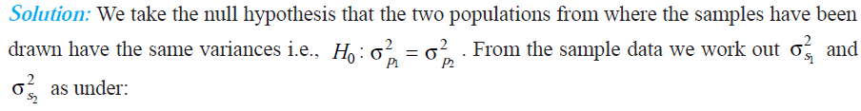
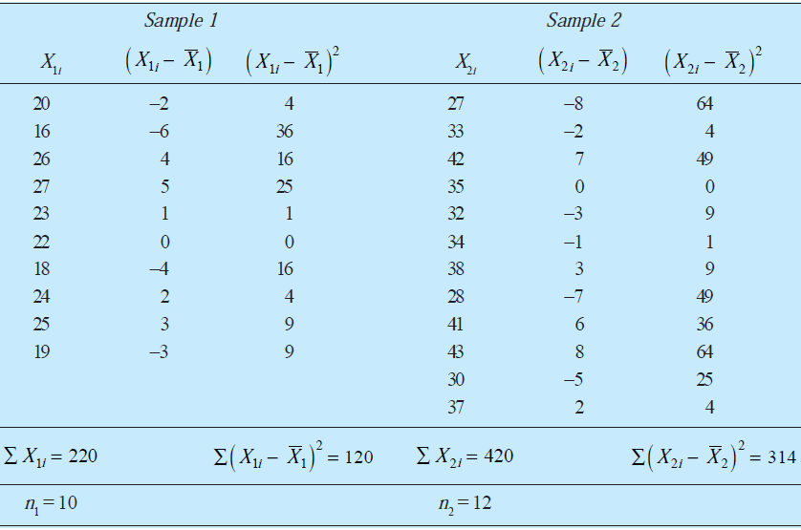

Slide 6
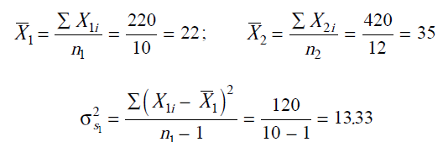
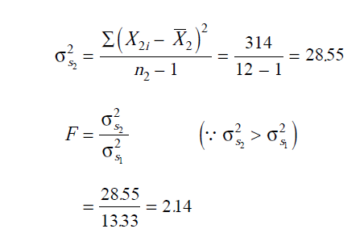


Slide 7
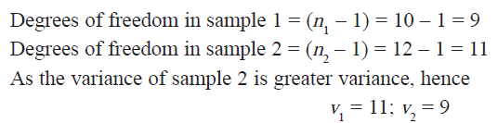
Since the calculated value of F = 2.14 which is less than 3.11 as such we accept the null hypothesis and conclude that samples have been drawn from two populations having the same variances.

Slide 8
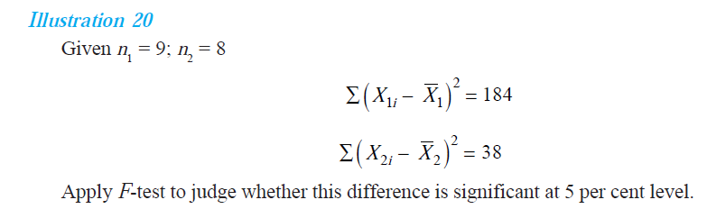

Slide 9
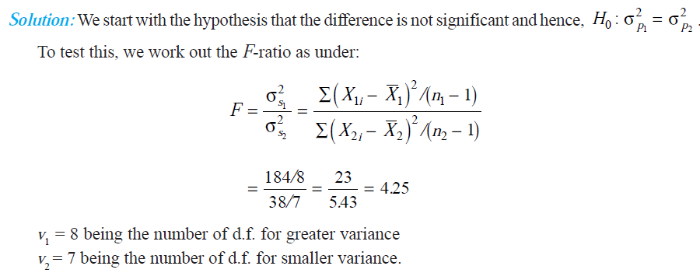

Slide 10
Mann-Whitney U-test
This was developed by H B Mann and R Whitney in 1940’s
Mann-Whitney U-Test is a non-parametric test used to test whether two independent samples were selected from population having the same distribution.
If sample size is small and we cannot or do not wish to make the assumption that the data is taken from normally distributed population, then Mann-Whitney U-test or simply U-test is used to test the equality of two population means.
This test is the substitute for t-test statistic when the stringent assumptions of parent population being normally distributed with equal variance are not met or when the data are only ordinal in measurement.

Slide 11
Example
The below data represents the number of bounced cheques in two banks – Bank A and Bank –B on randomly chosen 12 days for Bank A and 15 days for Bank B. Use a mann-Whitney U test to examine at a 5 per cent level of significance whether Bank A has more Bounced Cheques as compared to Bank B:
Bank A | 42 | 65 | 38 | 55 | 71 | 60 | 47 | 59 | 68 | 57 | 76 | 42
Bank B | 22 | 17 | 35 | 19 | 8 | 24 | 42 | 14 | 28 | 17 | 10 | 15 | 20 | 45 | 50

Slide 12


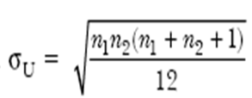

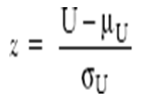
H0 = There is no difference in the bounce cheques of both the banks
Ha = Bank A has more boucned cheques then Bank B
We Pool both the samples and rank them shown in slide number 39.
Consider the lower value between U₁ and U₂ i.e., and substitute in U below

Slide 13
Number of Bounced Cheques | Bank | Rank
8 | B | 1
10 | B | 2
14 | B | 3
15 | B | 4
17 | B | 5.5
17 | B | 5.5
19 | B | 7
20 | B | 8
22 | B | 9
24 | B | 10
28 | B | 11
35 | B | 12
38 | A | 13
42 | A | 15
42 | A | 15
42 | B | 15
45 | B | 17
47 | A | 18
50 | B | 19
55 | A | 20
57 | A | 21
59 | A | 22
60 | A | 23
65 | A | 24
68 | A | 25
71 | A | 26
76 | A | 27
Total number of observation is 27, so we need to rank the observations from 1 to 27
Step 3: Calculate the Rank Sums
We calculate the sum of the ranks for the two groups
R1 = Sum of the ranks of Bank A =249
R2 = Sum of the ranks of Bank B =129

Slide 14
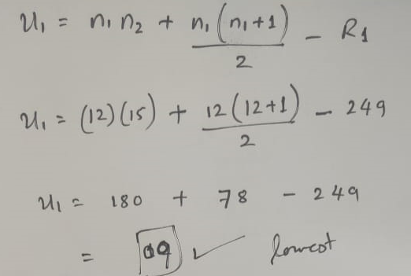
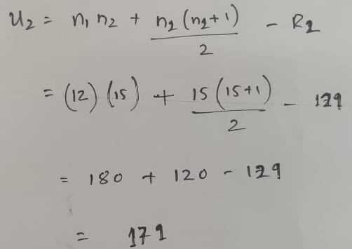


Slide 15
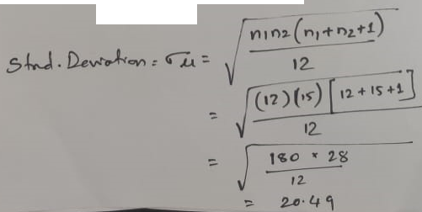

Slide 16
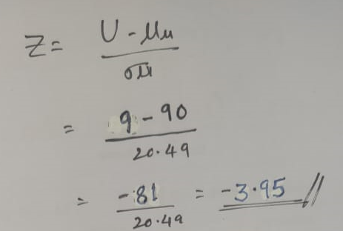
Consider the lower value between U₁ and U₂ i.e. U₂ = 9 so that

Slide 17
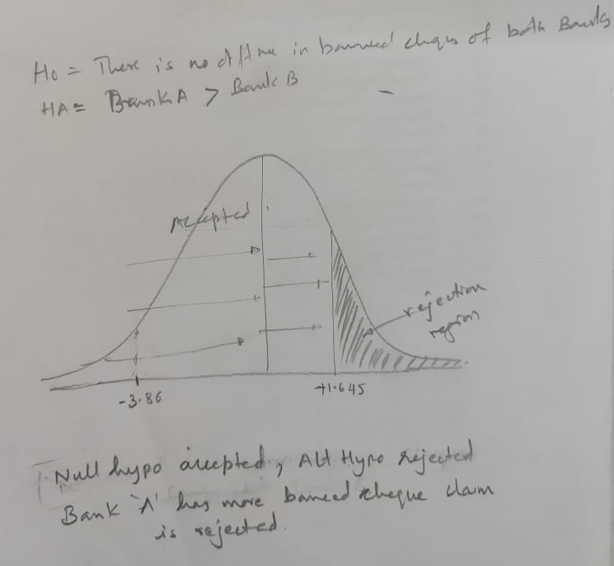

Slide 18
KRUSKAL-WALLIS TEST
KRUSKAL-WALLIS TEST
This test is the non-parametric alternative to the one-way analysis of variance to identify differences among populations that does not require any assumption about the shape of the population distribution. This test uses the ranks of the observations rather than the data themselves with the assumption that the observations are on an interval scale.

Slide 19
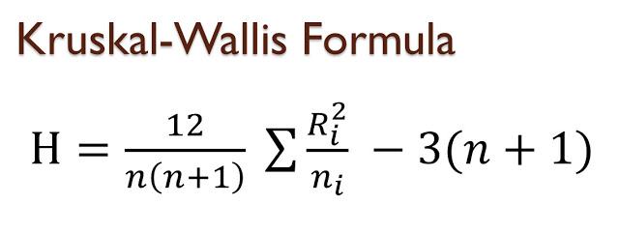
The test statistic used in this test is called the H statistic.
Obtain random samples of size n1, ….. Nk from each of the k population
Pool all the samples and rank them
Let ri = the total of the ranks from the ith sample
k = number of samples
n = total number of elements in k samples
This H value is approximately Chi-square distributed with k – 1 degrees of freedom as long as n_{j} is not less than 5 observations for any population

Slide 20
Example
Three machines are used in the packaging of 10 kg of wheat flour. Each machine is designed so as to pack on an average 10 kg of flour per bag. Samples of six bags were selected from each machine and the amount of wheat packaged in each bag is shown below;
Use a 5 per cent level of significance to test the hypothesis that the amount of wheat packaged by the three machines in the same
Machine 1 | 15.8 | 15.9 | 16.2 | 15.7 | 16.3 | 15.8
Machine 2 | 16.5 | 16 | 15.4 | 15.9 | 16.2 | 16.1
Machine 3 | 15.7 | 16.4 | 16.2 | 15.9 | 15.7 | 16.3

Slide 21
Weight | Rank | Machine
15.4 | 1 | 2
15.7 | 3 | 1
15.7 | 3 | 3
15.7 | 3 | 3
15.8 | 5.5 | 1
15.8 | 5.5 | 1
15.9 | 8 | 1
15.9 | 8 | 3
15.9 | 8 | 2
16 | 10 | 2
16.1 | 11 | 2
16.2 | 13 | 1
16.2 | 13 | 2
16.2 | 13 | 3
16.3 | 15.5 | 1
16.3 | 15.5 | 3
16.4 | 17 | 3
16.5 | 18 | 2
r1 (Total of ranks from machine 1) = 50.5
r2 (Total of ranks from machine 2) = 61
r3 (Total of ranks from machine 3) = 59.5
Solution:
H0: Amount of wheat packaged by the three machines is same
H1: Amount of wheat packaged by at least two machines is different

Slide 22
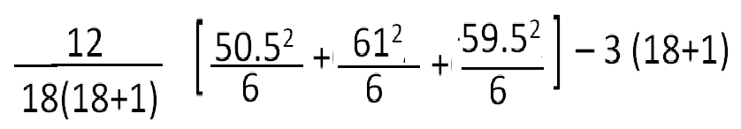

H follows a χ² distribution with 2 df. The same value of χ² of 0.41 is to be compared with the critical value of χ² , which in the present case is 5.99. As sample χ² is less than the critical χ² the null hypothesis is accepted.
Therefore, there is no significant difference in the amount of wheat packaged by the three machines.

Slide 23
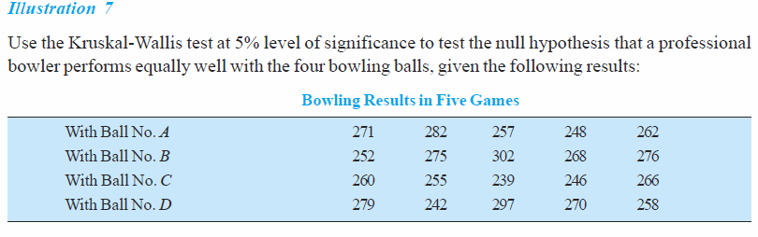

Slide 24
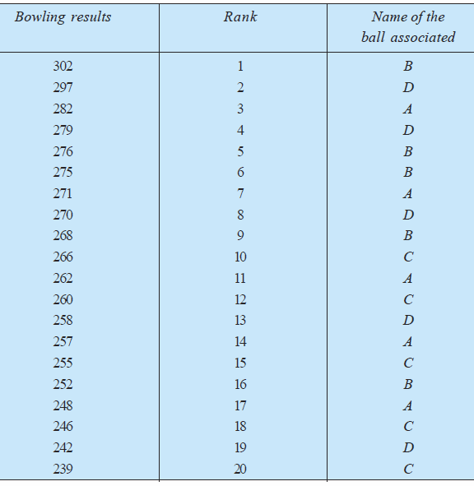

Slide 25
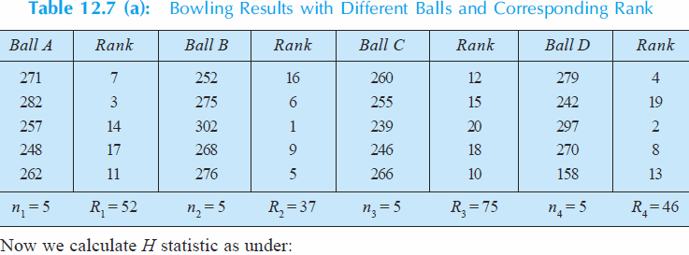

Slide 26
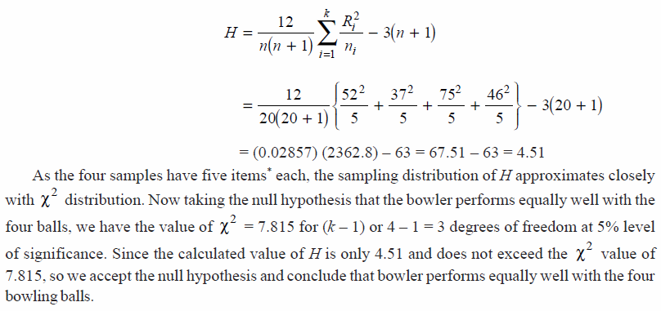

Slide 27
CHI-SQUARE TEST
The chi-square test is an important test amongst the several tests of significance developed by statisticians.
Chi-square, symbolically written as X² (Pronounced as Ki-square), is a statistical measure used in the context of sampling analysis for comparing actual variance (observed) to a theoretical variance (expected).
It is particularly useful in tests involving nominal data
Typical are cases where persons, events, or objects are grouped in two or more nominal categories such as "yes-no," true false, male female, "favor-undecided-against" or class ‘A,B,C, or D’.

Slide 28
Using this technique, we test for significant differences between the observed distribution and the expected distribution based on the null hypothesis.
When we use chi-square as a test for population variance, we have to work out the value of X² to test the null hypothesis.
Then by comparing the calculated value with the table value of X² for (n – 1) degrees of freedom at a given level of significance, we may either accept or reject the null hypothesis.
If the calculated value of X² is less than the table value, the null hypothesis is accepted, but if the calculated value is equal or greater than the table value, the hypothesis is rejected.
This test is evaluated to see whether the difference between the observed frequencies and the expected frequencies under the null hypothesis can be attributed to chance or actual population differences

Slide 29
The X²-distribution is not symmetrical and all the values are positive.
Table value specifies critical values of X² for the different degrees of freedom.
Chi-square is useful in cases of one-sample analysis, two independent samples, or k independent samples.

Slide 30
As a non-parametric test, chi-square can be used (i) as a test of goodness of fit and (ii) as a test of independence
As a test of goodness of fit, X² test enables us to see how well does the assumed theoretical distribution (such as Binomial distribution, Poisson distribution or Normal distribution) fit to the observed data.
If the calculated value of X² is less than the table value at a certain level of significance, the fit is considered to be a good one which means that the divergence between the observed and expected frequencies is attributable to fluctuations of sampling.
But if the calculated value of X² is greater than its table value, the fit is not considered to be a good on

Slide 31
As a test of independence, X² test enables us to explain whether or not two attributes are associated.
For instance, we may be interested in knowing whether a new medicine is effective in controlling fever or not, X² test will helps us in deciding this issue.
In such a situation, we proceed with the null hypothesis that the two attributes (viz., new medicine and control of fever) are independent which means that new medicine is not effective in controlling fever.
On this basis we first calculate the expected frequencies and then work out the value of X². If the calculated value of X² is less than the table value at a certain level of significance for given degrees of freedom, we conclude that null hypothesis stands, which means that the two attributes are independent or not associated (i.e., the new medicine is not effective in controlling the fever).

Slide 32
CONDITIONS FOR THE APPLICATION OF X²TEST
The following conditions should be satisfied before X² test can be applied:
(i) Observations recorded are collected on a random basis.
(ii) All the items in the sample must be independent.
(iii) No group should contain very few items, say less than 10.
10 is regarded as better by most of the statisticians.
(iv) The overall number of items must also be reasonably large. It should normally be at least 50.
(v) The constraints must be linear. (i.e., equations containing no squares or higher powers of the frequencies) are known as linear constraints.

Slide 33
CHI-SQUARE AS A TEST FOR COMPARING population VARIANCE

Slide 34
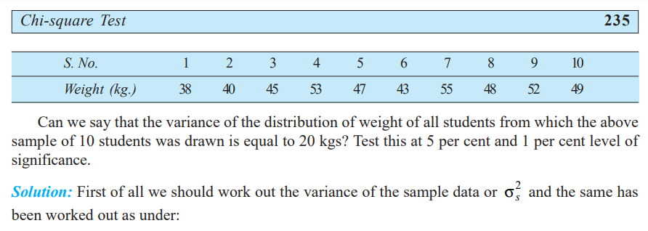
Illustration 1 Weight of 10 students is as follows:

Slide 35
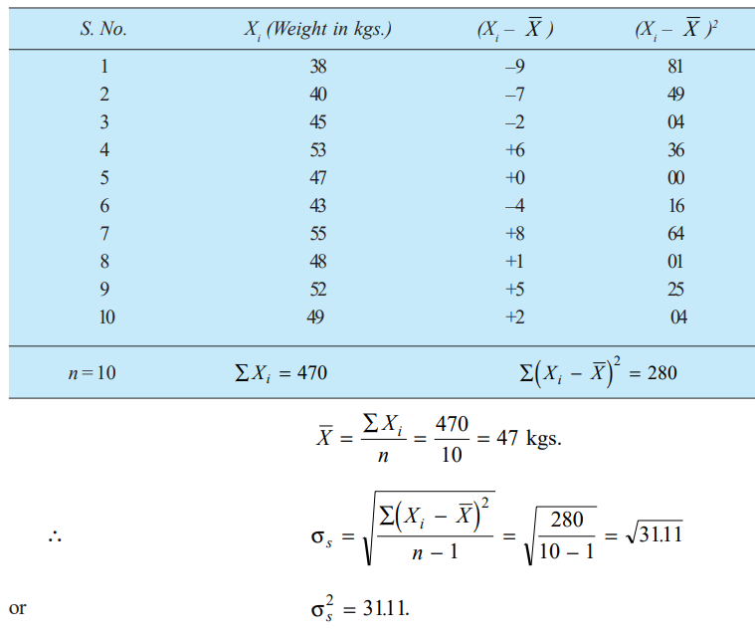

Slide 36
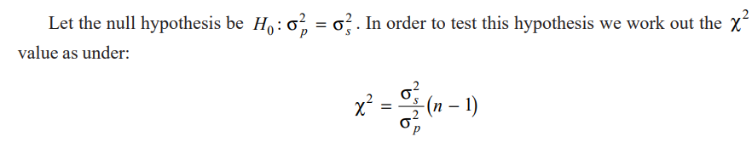
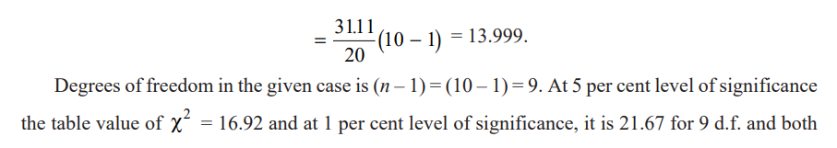
Since calculated value is less than the table value we accept the null hypothesis and conclude that the variance of the given distribution can be taken as 20 kgs at 5 per cent as also at 1 per cent level of significance. In other words, the sample can be said to have been taken from a population with variance 20 kgs

Slide 37
Illustration 2
A sample of 10 is drawn randomly from a certain population. The sum of the squared deviations from the mean of the given sample is 50. Test the hypothesis that the variance of the population is 5 at 5 per cent level of significance.

Slide 38
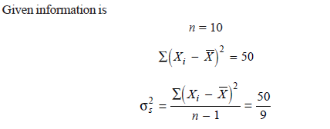
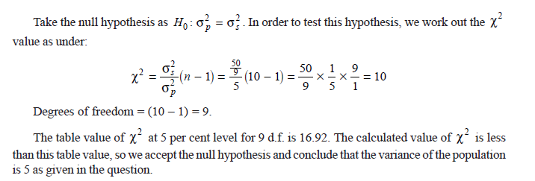

Slide 39
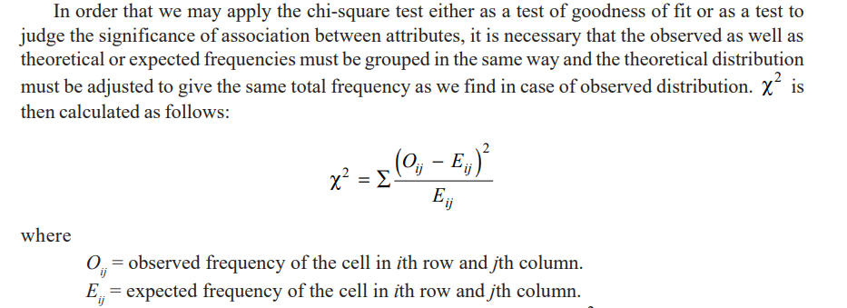
CHI-SQUARE AS A NON-PARAMETRIC TEST
As a non-parametric test, chi-square can be used (i) as a test of goodness of fit and (ii) as a test of independence.

Slide 40
If there are 10 frequency classes and there is one independent constraint, then there are (10 – 1) = 9 degrees of freedom.
Thus, if ‘n’ is the number of groups and one constraint is placed by making the totals of observed and expected frequencies equal, the d.f. would be equal to (n – 1).
In the case of a contingency table (i.e., a table with 2 columns and 2 rows or a table with two columns and more than two rows or a table with two rows but more than two columns or a table with more than two rows and more than two columns), the d.f. is worked out as follows: d.f. = (c – 1) (r – 1) where ‘c’ means the number of columns and ‘r’ means the number of rows.

Slide 41
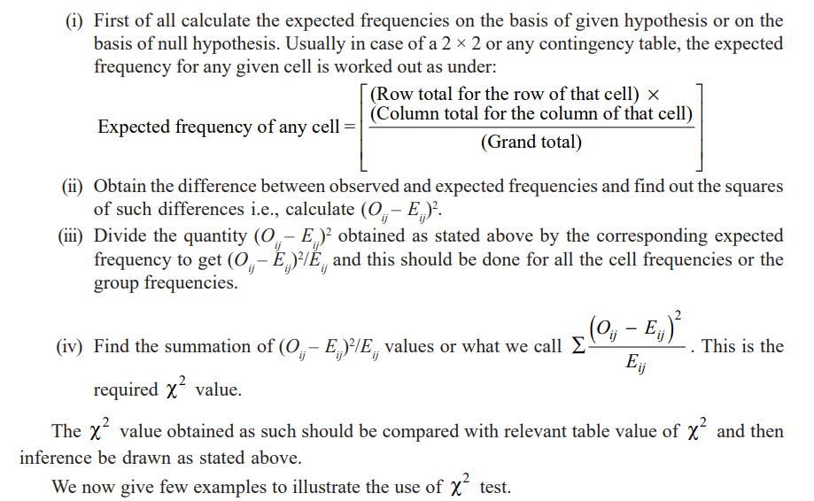

Slide 42
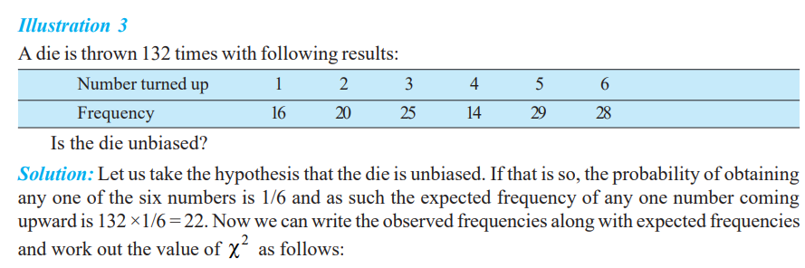

Slide 43
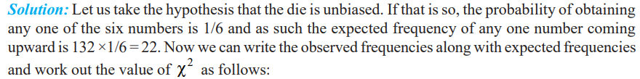
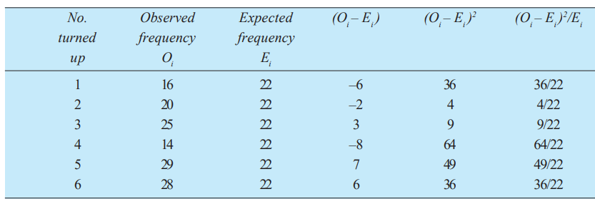

Slide 44
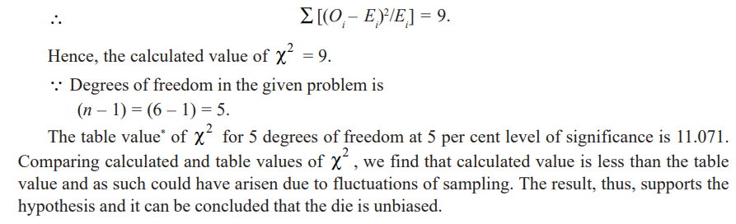

Slide 45
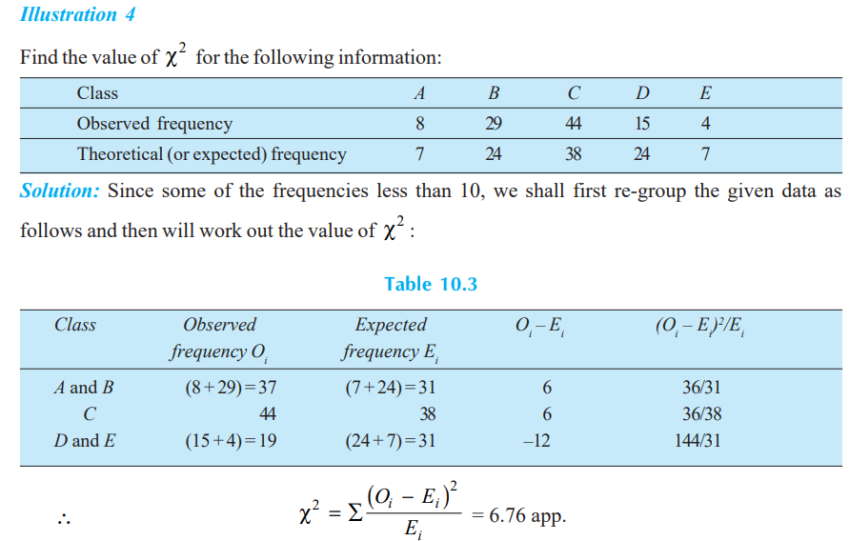

Slide 46
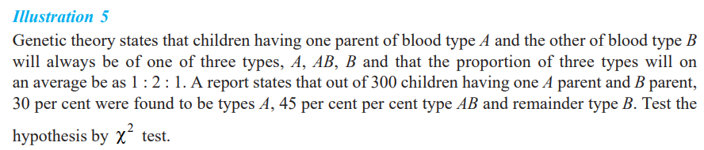

Slide 47
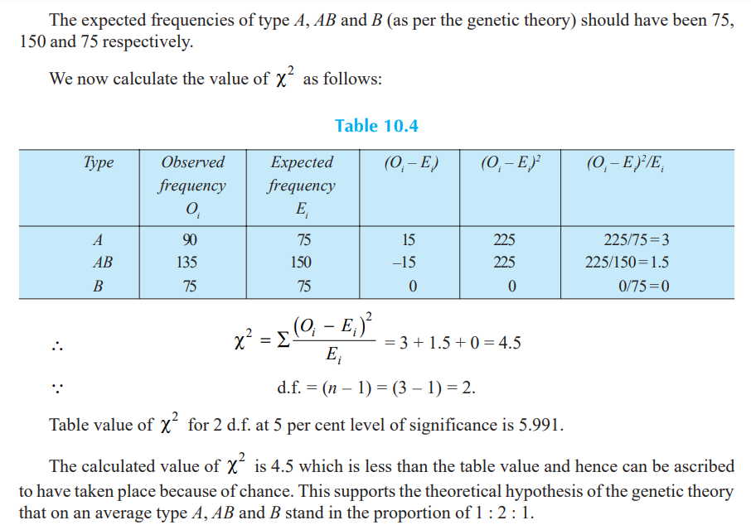

Slide 48
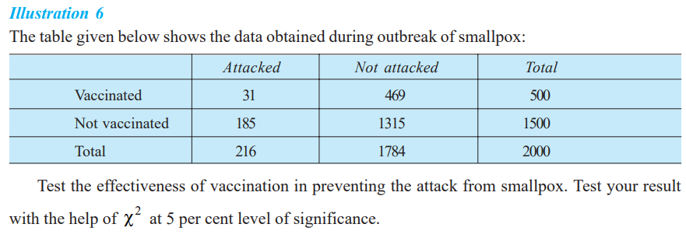

Slide 49
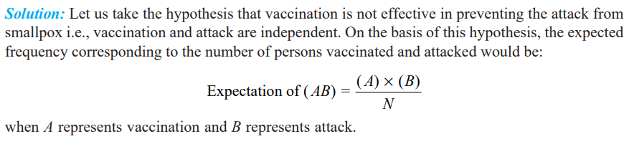
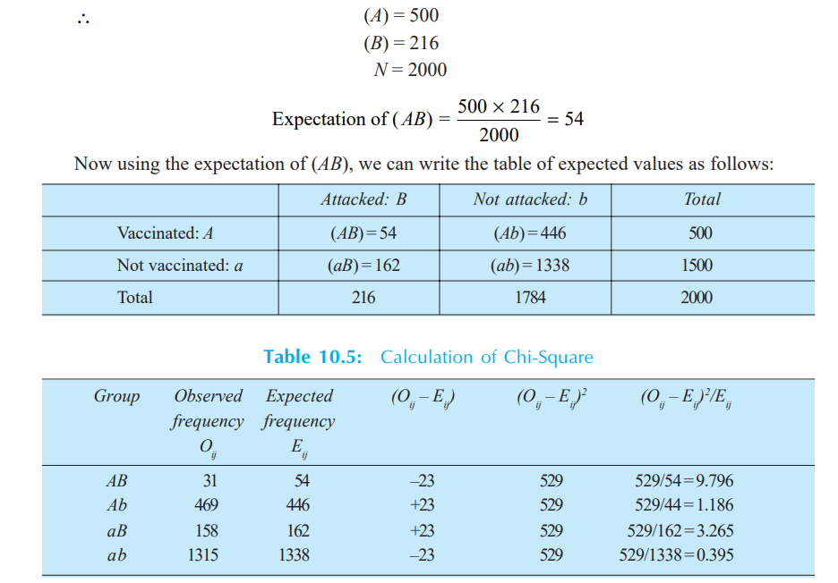

Slide 50
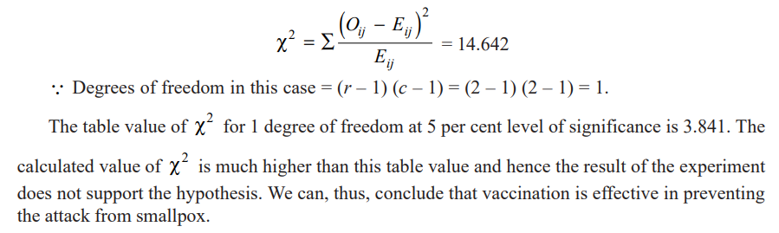

Slide 51
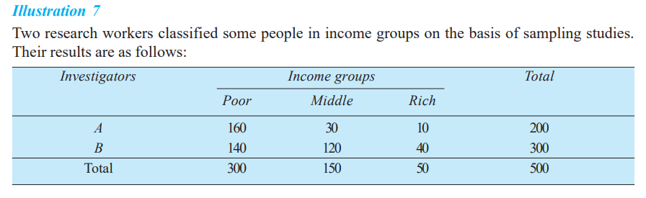
Show that the sampling technique of at least one research worker is defective.
Solution: Let us take the hypothesis that the sampling techniques adopted by research workers are similar (i.e., there is no difference between the techniques adopted by research workers). This being so, the expectation of A investigator classifying the people in

Slide 52
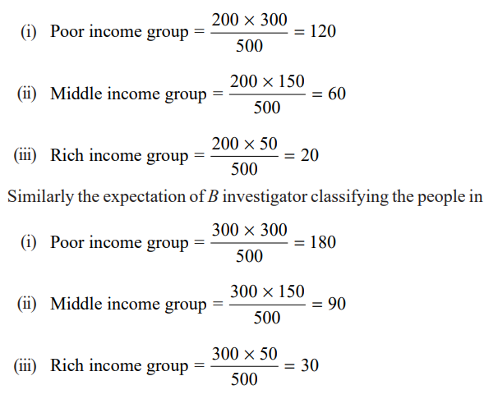

Slide 53
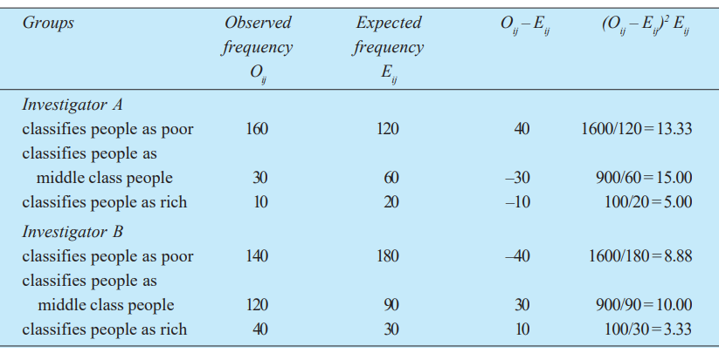

Slide 54
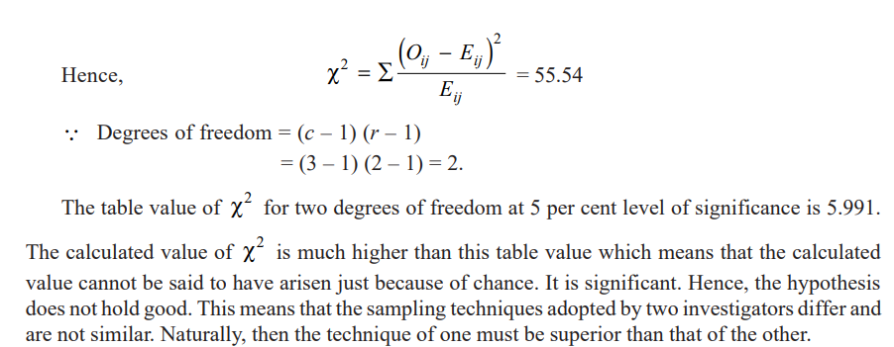

Slide 55
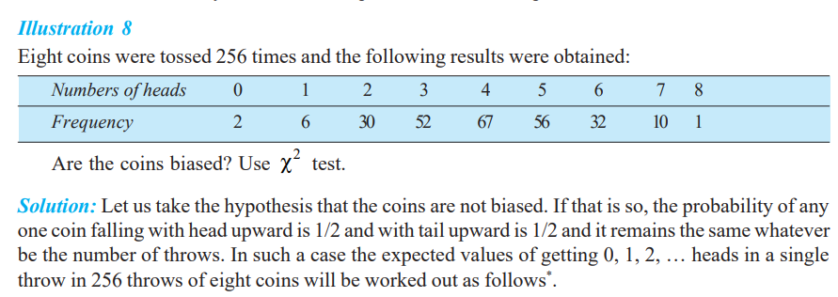



Slide 56
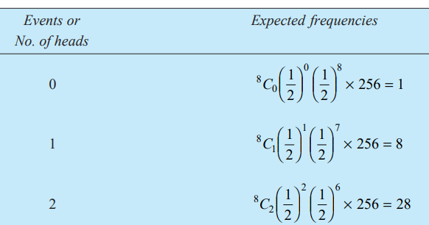
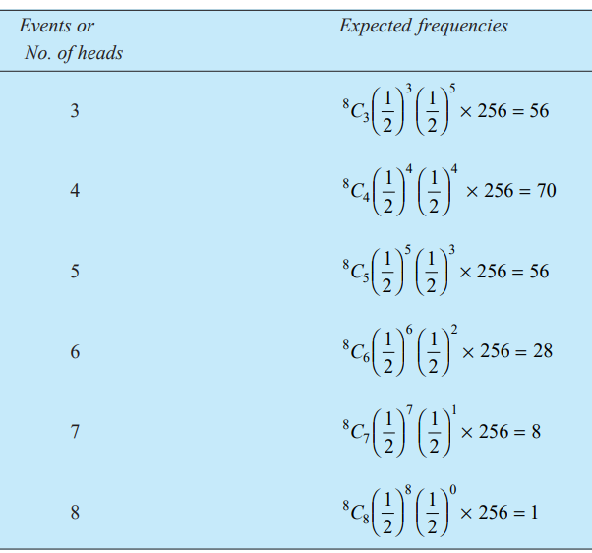

Slide 57
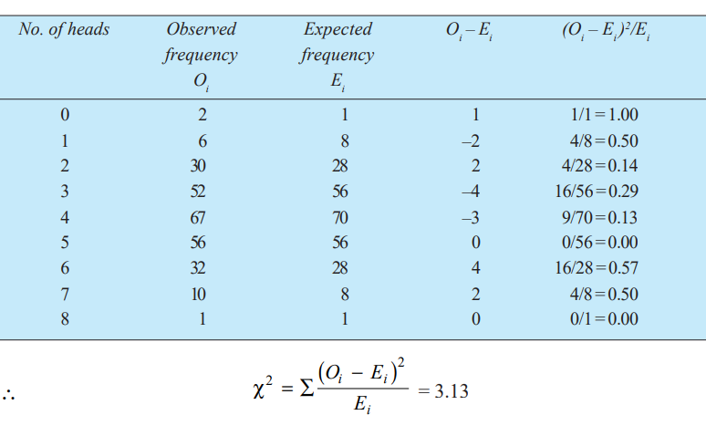

Slide 58
